Slide 1
surface EMG for dexterous hand prostheses force control
surface electromyography is a non-invasive, well-known, relatively cheap way of roughly controlling s.o.a., non-dexterous hand prostheses
we have investigated how to use it to finely control a dexterous mechanical hand / prosthesis (e.g., Touch Bionics’s i-LIMB)
performed three experiments, employing machine learning to control the force involved in a number of different grasp types, online and in real-time

Slide 2
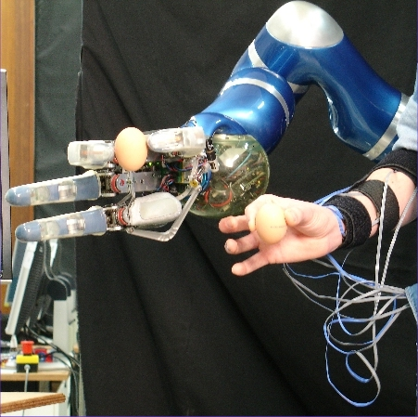
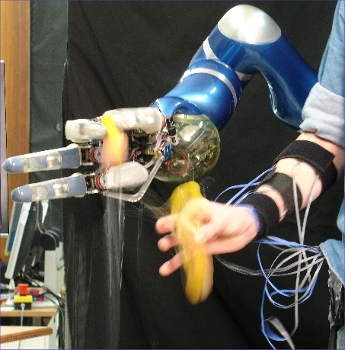
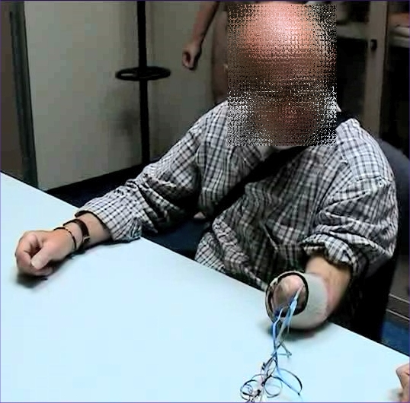
surface EMG for dexterous hand prostheses force control
at DLR, Germany 10 electrodes+force sensor; in highly controlled conditions, on one healthy subject (see Patrick van der Smagt’s talk)
at IIT, Italy 7 electrodes+force sensor; in non-controlled conditions, on 10 healthy subjects
at INAIL, Italy 5 electrodes+force sensor; on a long-time amputee (see poster)

Slide 3
surface EMG for dexterous hand prostheses force control
results:
  works fine both in controlled and non-controlled conditions
  works fine multi-subject
  works fine for the amputee, too, who is able to generate very different signals for each grasp type and to precisely modulate the involved force (up to 0.95 correlation to real force)
scenario: upcoming hand prostheses (with 4+ DOFs) can be finely controlled with as few as 5 EMG electrodes

